Slide 1
Best Buy for Business User Experience & Schedule
Digital Experience & Usability

Slide 2
AGENDA
1
2
3
4
Business Goals
Current Page Performance
UX Approach
Schedule
Notes:
Business goals
Ux goals and kpi
Form conversion (compared to baseline)
Awareness & Credibility
increase in continent dedicated to initiatives
Lead generation
hypothesis: a lead form is better than the mail to link
Account manager support
Shareable content: leverage 3rd party endorsement
Website organization
Analyze current traffic
In and out traffic, highly related search
Mobile heavy
Search terms correlate with popular searches
Hypothesis: mistap
Next steps
Add tracking code to current page
begin google expedition page
Add web form
A/B test mail link vs form
Discuss
Create edu page
Merchandizing and product driven
Todo
Make presentation
finish analytics
Education page: add featured google analytics
Home page new slide
Move global footer to last push

Slide 3
BUSINESS GOALS

Slide 4
BUSINESS GOALS
Business Goals
Awareness & Credibility: More content to explain solutions
Generate 5 leads/day - Increase in contacts initiated on the site.
Support Account Managers : Structure content to focus on:
Facilitate follow up
leverage 3rd party endorsement

Slide 5
C URRENT PAGE PERFORMANCE

Slide 6
CURRENT PAGE PERFORMANCE
How is the current page doing?
1600 visits per day in Feb 2017
Low exit rate: 17% just like homepage
People spending less than 15 sec on the page: home 67%; BBfB 90%
Site Search part of the most popular paths before and after page
Search terms correlate with popular terms (Nintendo Switch) as well as expected business terms (laptop)
High percentage is mobile (site 37%; BBfB: 86%)
Notes:
March 1-8th
(note that reports use this month timeframe so your numbers may vary)
KPIs and analysis
https://confluence.ca.bestbuy.com/pages/editpage.action?pageId=12157036
Thanks Matt St. John!

Slide 7
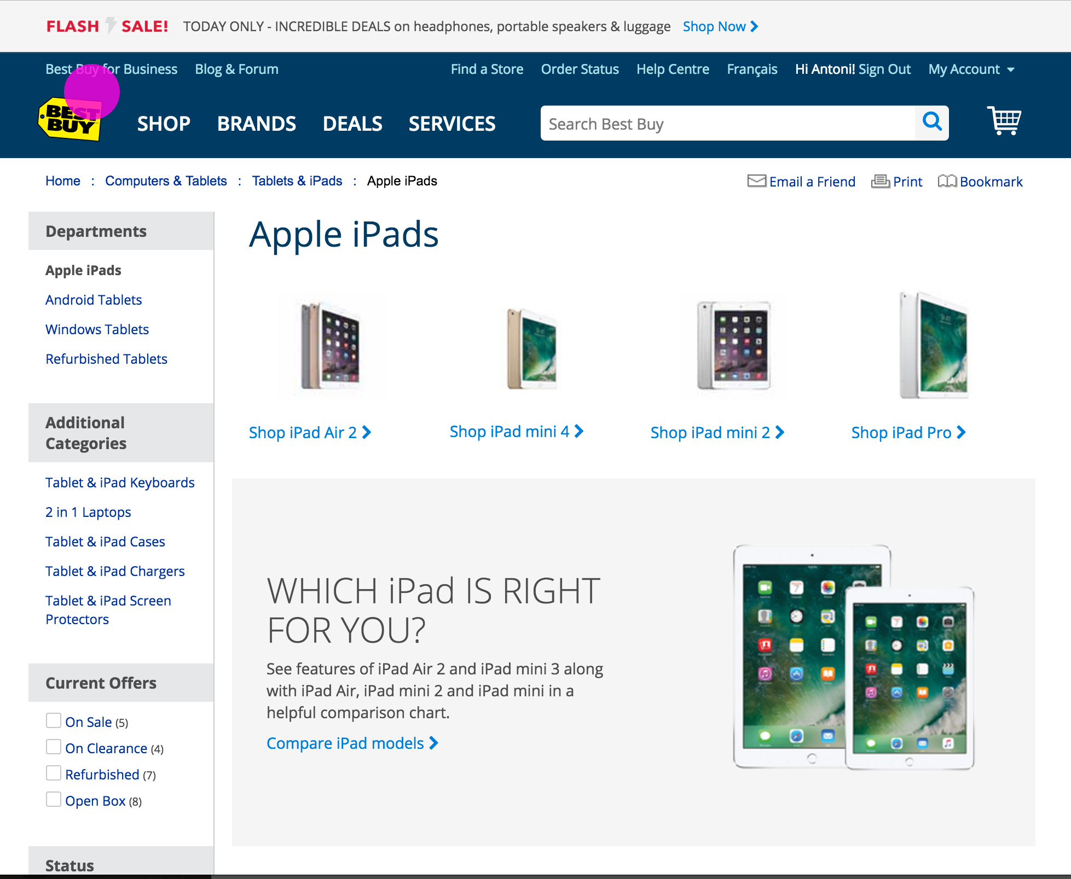
CURRENT PAGE PERFORMANCE
Hypothesis: ‘Fat fingers’ on mobile
The pink dot is the approximate size of a finger cursor in Google Chrome
This suggests that a significant of the traffic to Best Buy for Business in unqualified.

Slide 8
CURRENT PAGE PERFORMANCE
Next Step: Add link tracking
Add tracking to current page so that a baseline can be established:
How many people click the email link
How many people interact with elements on the page
Create a segment for people that interacted with the page to learn more

Slide 9
UX APPROACH, SITEMAP & PROTOTYPE

Slide 10
UX APPROACH
General UX Solution
Improve Call To Action to contact Account Manager
Site organization for follow up
Site organization for 3rd party endorsement
Site organization recommendations: verticals, solutions (& value props), case studies
Minor usability improvements, e.g. breadcrumbs

Slide 11
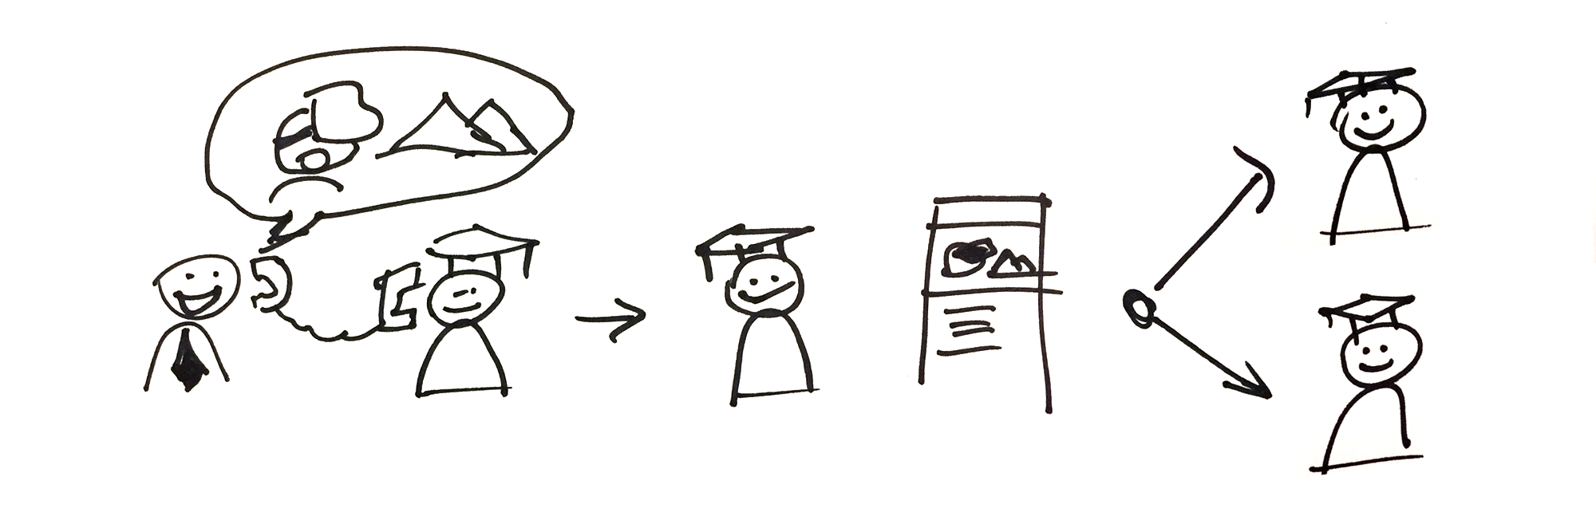
UX APPROACH
FOLLOW UP CONTENT
Make sure that any follow up content matches the conversation.
Individual solutions should be pages, just like Best Buy US.
Notes:
Since there are solutions based pushes and conversations around specific items of interest.

Slide 12
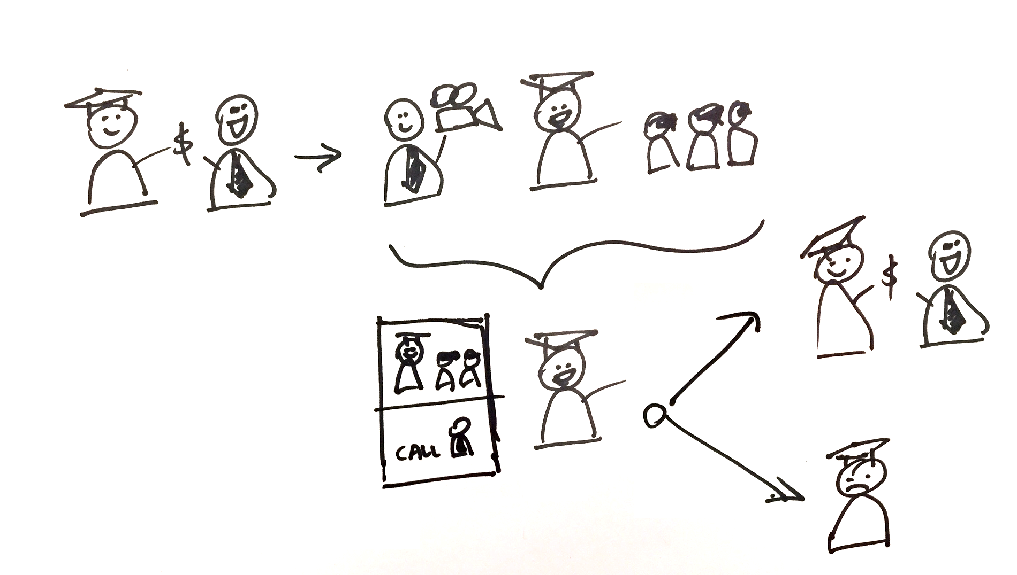
UX APPROACH
3RD PARTY ENDORSEMENT
Give clients a vehicle to celebrate/brag with our content (and our CTAs).
Leverage blogs to produce content quickly.

Slide 13
UX APPROACH
TYPES OF CONTENT
4 types of content
Vertical: Industry driven collection of solutions Education, hotels & recreation, corporate
Solution: The most basic offer, it’s supported by value propositions Google Expedition, Network setup
Value proposition: why select best buy, supports many/all solutions Assortment, Geek Squad service, Account manager support
Case study: Client-specific mix of solutions and value props or example of a solution Private school X bought Google Expeditions and Digital Signage

Slide 14
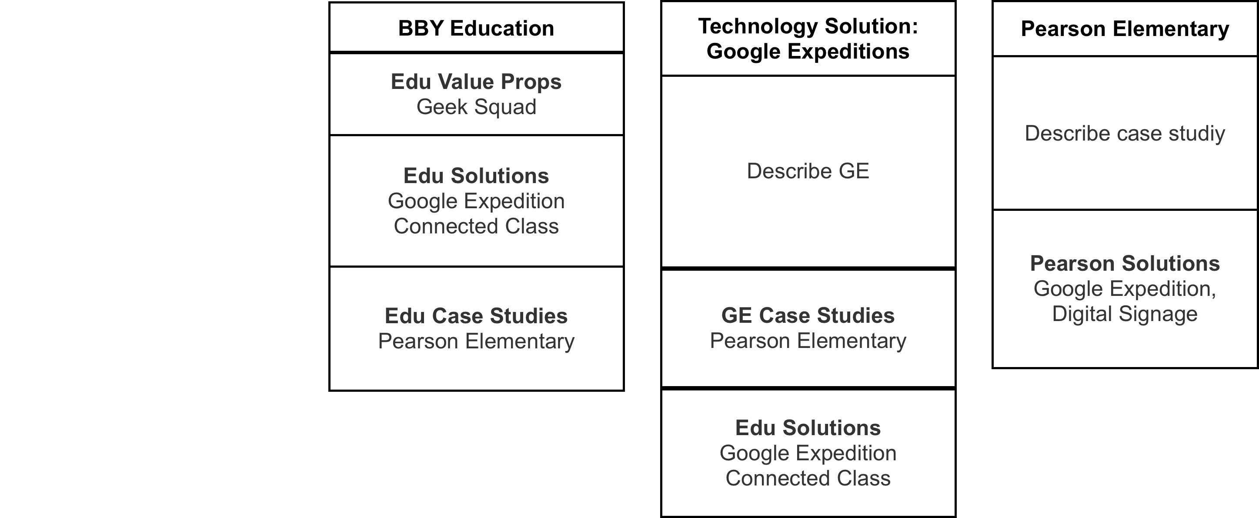
UX APPROACH
VERTICAL ORGANIZATION

Slide 15
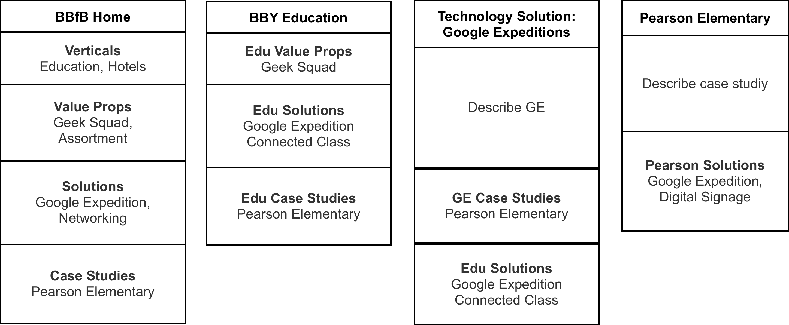
UX APPROACH
VERTICAL ORGANIZATION + FUTURE MAIN PAGE
Notes:
Requires more complete verticals

Slide 16
PROTOTYPE

Slide 17
TIMELINE
Priorities & Timeline
Initial work
Google expeditions page: Live Tuesday March 21st
Contact form (& callouts): Live March 28th (requires relation1)
Education main page: Live Tuesday April 18th
Next Wave
Product-driven template (eg: Student Devices) 30hrs
5 pages based on templates (story or product driven: 150hrs
Notes:
Initial work (each step can be a shippable increment)
Technology story solution: Google expeditions page: 35 hrs @ 100% Live Tuesday March 21st
Note: Nick is off April 4th to 11th
Design 1 email form, add callouts to BBfB main landing page: @ 40% Live March 28, requires relation1/empix)
Vertical landing page: Education: 30 hrs @ 40% Live April 18th
Next Wave
Product driven template: Student Devices 30hrs.
5 pages based on templates (story or product driven: 150 hrs per page
Technology story template: Google Expeditions- March 21
2. Form- March 28
3. Vertical landing Education page-April 18

Slide 18
NEXT STEPS
Next Steps
Add tracking code to current BBfB page
Talk to clients
Begin Google Expedition page
Add web form A/B test mail link vs form
Create Education main page
Merchandizing and product driven template

Slide 19
THANK YOU

